Slide 1
Databases Presentation
Group 13
Andreas Richardsen
Zahro-Madalina Khaji
Notes:
This is our DB Presentation, this is A and I am M and today we will discuss how we decided on requirements, diagrams and implementation for our GTL database

Slide 2
SQL vs NoSQL
Currently SQL
Future Polyglot Database

Slide 3
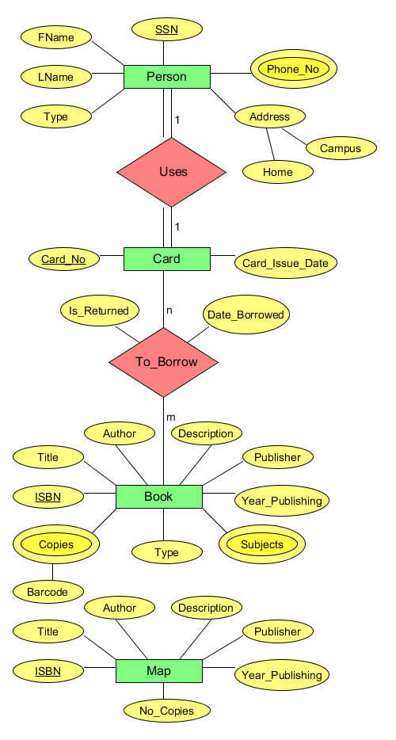
ER and EER Diagrams Discussion
Transformation rules
Notes:
Talk about transforming ER to EER, how we did it

Slide 4
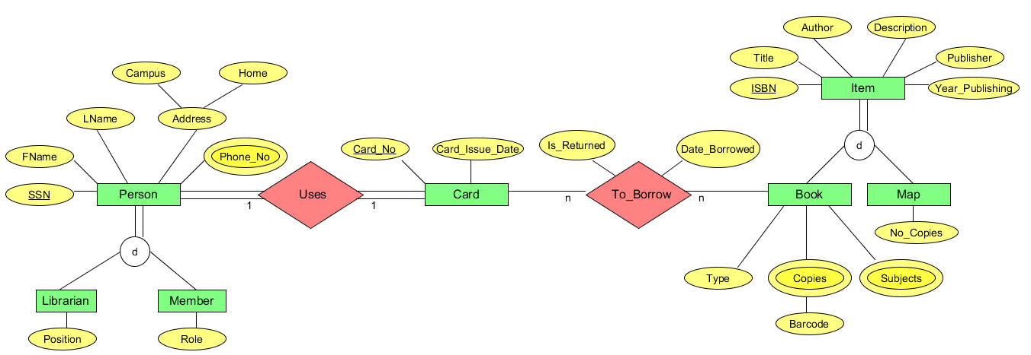
ER and EER Diagrams Discussion
Transformation rules
Notes:
Talk about transforming ER to EER, how we did it

Slide 5
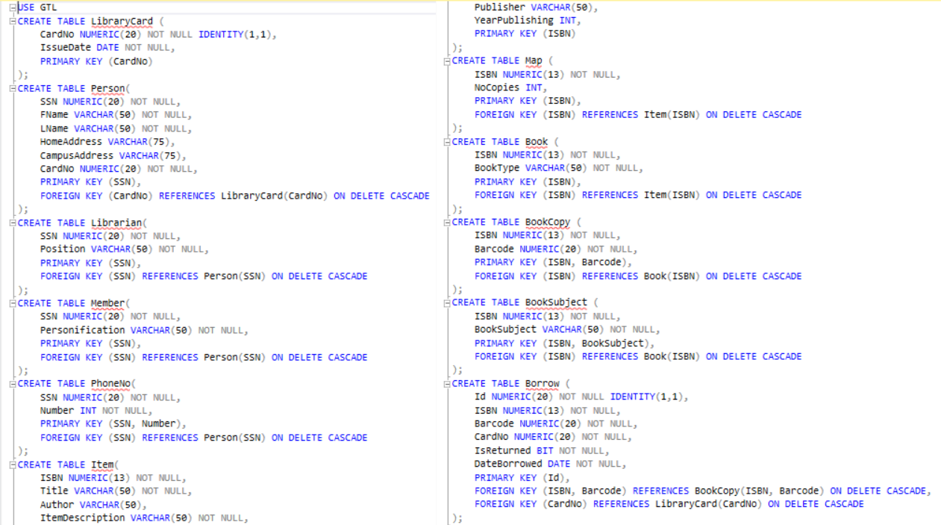
DDL Statement
Include just one ddl statement

Slide 6
Data generation
SQL Data Generator 4
Bad data
No constraints on creation
Didn’t affect our queries
Notes:
The reason why we didn’t have constraints on creation is because we didn’t consider the data generation as we would put constraints on the insertion query instead

Slide 7
Query design –look up book by title

Slide 8
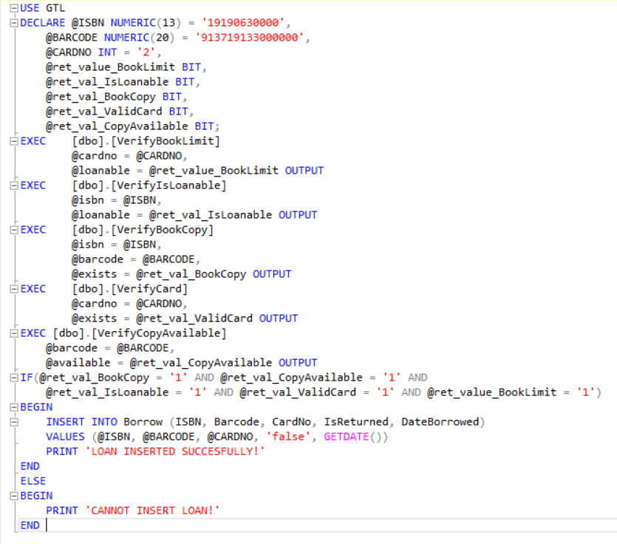
Query Design –Insert loan

Slide 9
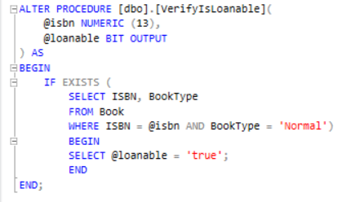
Database Programming – Stored Procedures
VerifyIsLoanable procedure

Slide 10
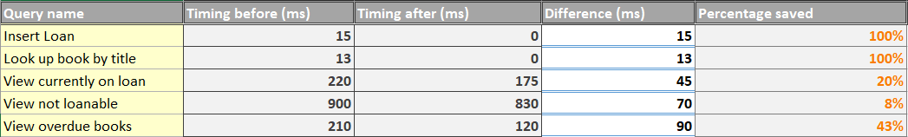
Indexes
View currently on loan – 8.67
View not loanable – 14.83
Look up book by title – 99.27
Insert loan – 98.74
View overdue books – 0/none
Notes:
Insert figure 16

Slide 11
Concurrency
Why no concurrency
Notes:
We didn’t have concurrency because that how we designed the system – to be used by one user at a time

Slide 12
Reflection
ER and EER
DB programming
DB procedures
Indexes

Slide 13
Test Presentation
Group 13
Andreas Richardsen
Zahro-Madalina Khaji
Notes:
This is our Test presentation, this is A and I am M, and we will discuss our reasoning and choices when working on the tests for the GTL project. A lot of our decisions were heavily influenced by our available resources, mainly time and that is why we decided to omit certain things we will discuss further in this pp.

Slide 14
Agile testing
Agile test quadrants

Slide 15
TDD
How it went?
Started with integration tests, and then unit tests

Slide 16
Coding standards
Clean Code book
Concept naming convention

Slide 17
Test levels
Unit test
Integration test
System
Acceptance

Slide 18
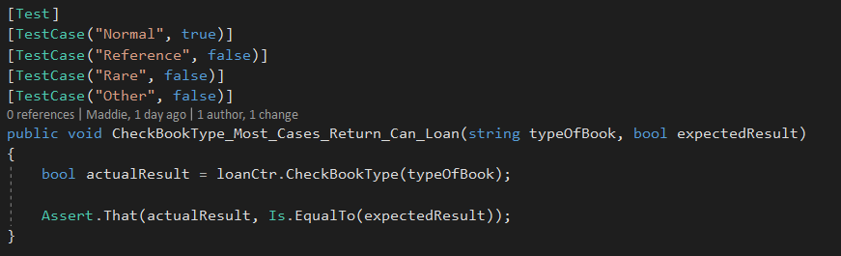
Unit tests
Add code example and talk about it

Slide 19
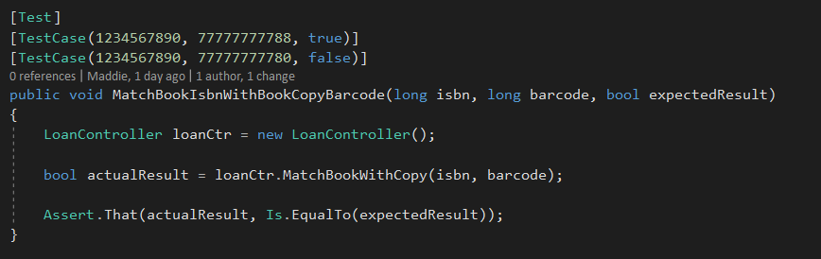
Integration tests
Add code example and talk about it

Slide 20
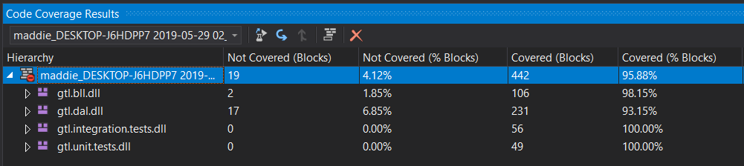
Test coverage

Slide 21
Designing a testable architecture
Talk about dependency injection

Slide 22
Reflection
Enjoyed TDD
Disliked testing documentation
Redundant documentation
The value of coding standards

